Slide 1


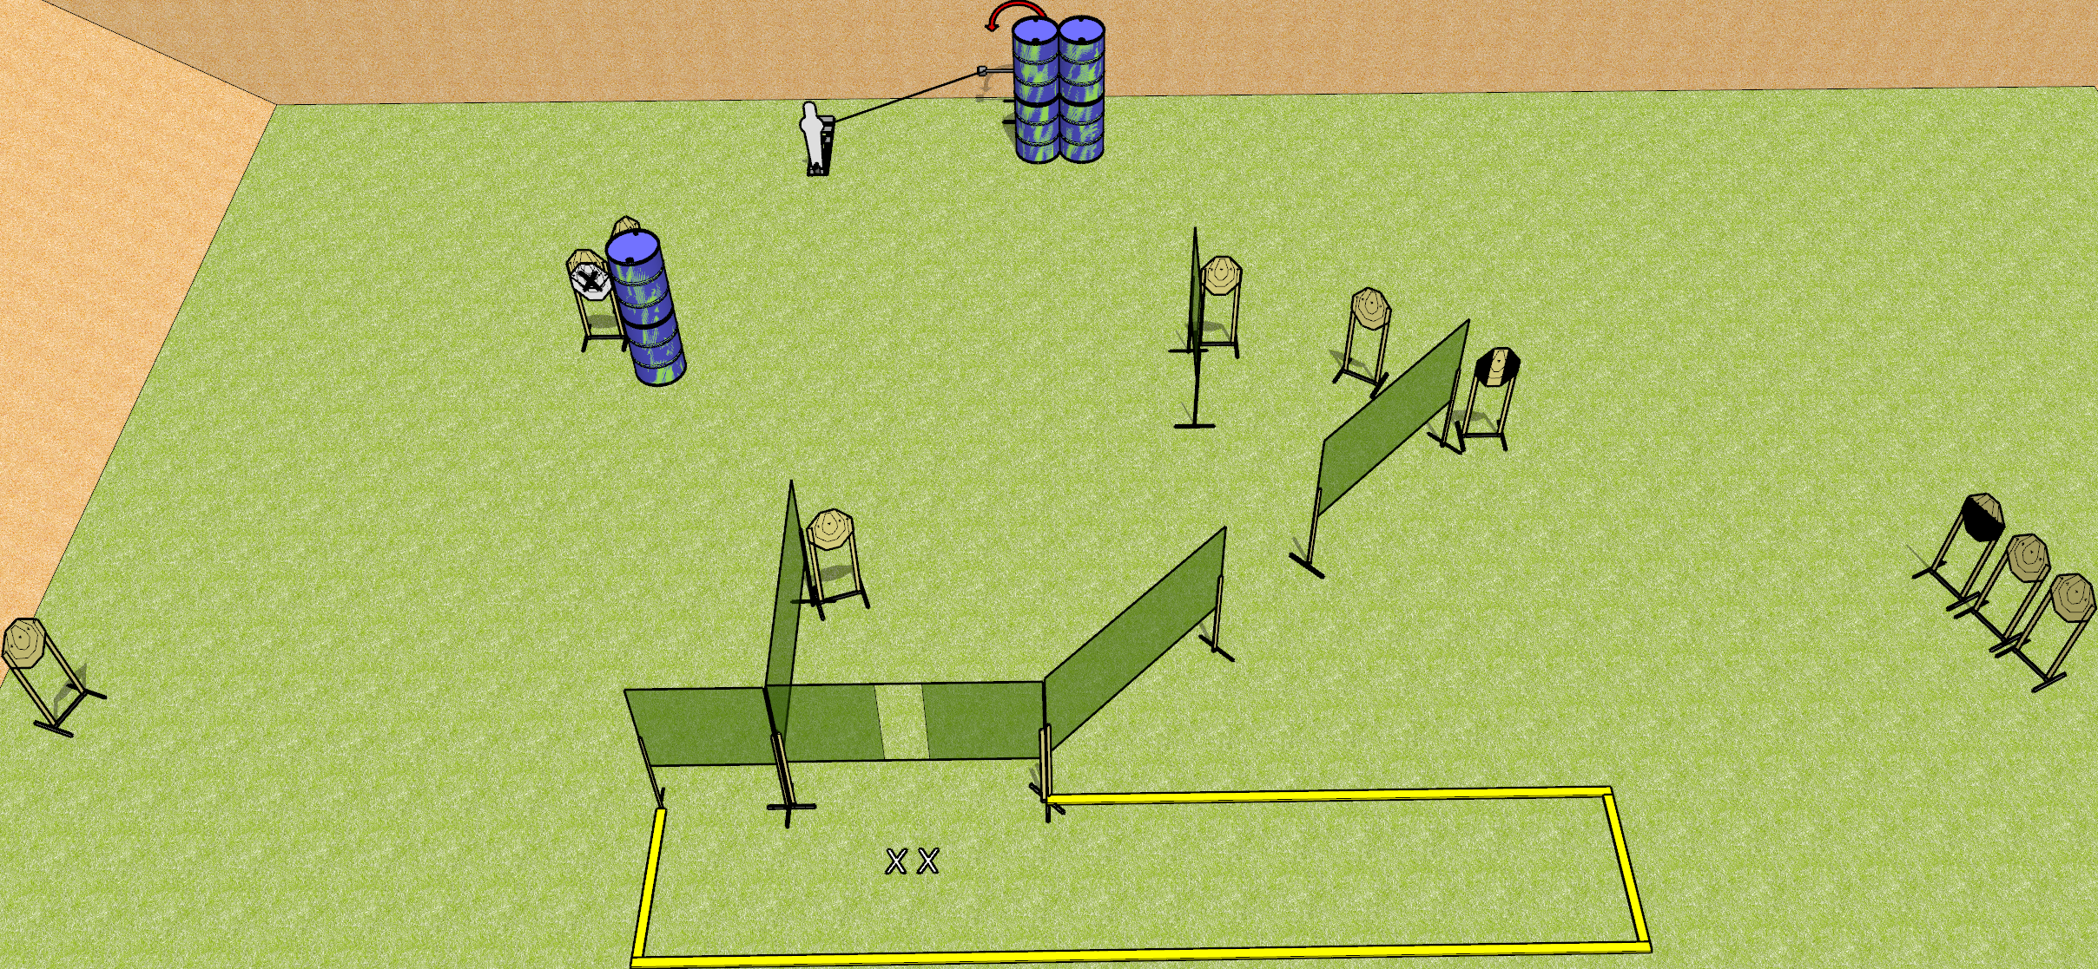
 | Dothan Gun Club – USPSA Match Something Course Designer : Drew Coleman
Round Count 23 rounds 11 IPSC 1 popper
Equipment List 1 swinger + activator 9 wall feet 2 medium fault lines 1 tux, 1 25%

Slide 2
Something
Written Stage Briefing
Something is a 23 round, 115 point, Comstock course of fire. There are 11 IPSC targets and 1 popper. The best 2 hits on paper will score, and steel must fall to score. The start signal is audible.
The swinger is activated by the popper, and remains visible at rest.
Handgun start position is both feet on X’s, wrists below belt. Handgun is loaded and holstered.
PCC start position is both feet on X’s, stock on belt. Carbine is loaded
On start signal, engage targets as they become available from within the shooting area.

